Slide 1
Transition Systems
Course: CS60030
FORMAL Systems
Pallab Dasgupta
Professor,
Dept. of Computer Sc & Engg

Slide 2
Overview Lecture #1
⇒ Transition systems
Executions
Modeling data-dependent systems

Slide 3
Transition Systems
model to describe the behaviour of systems
digraphs where nodes represent states, and edges model transitions
state:
the current colour of a traﬃc light
the current values of all program variables + the program counter
the current value of the registers together with the values of the input bits
transition: (“state change”)
a switch from one colour to another
the execution of a program statement
the change of the registers and output bits for a new input

Slide 4
Transition System
A transition system TS is a tuple (S, Act, →, I, AP, L) where
S is a set of states
Act is a set of actions
→ ⊆ S × Act × S is a transition relation
I ⊆ S is a set of initial states
AP is a set of atomic propositions
L : S → 2^{AP} is a labeling function
S and Act are either ﬁnite or countably inﬁnite
Notation: s → s' instead of (s, α, s' ) ∈ →
α

Slide 5
A Beverage Vending Machine
pay
get sprite
get_coke
insert coin
sprite
τ
select
τ
coke
states? actions?, transitions?, initial states?

Slide 6
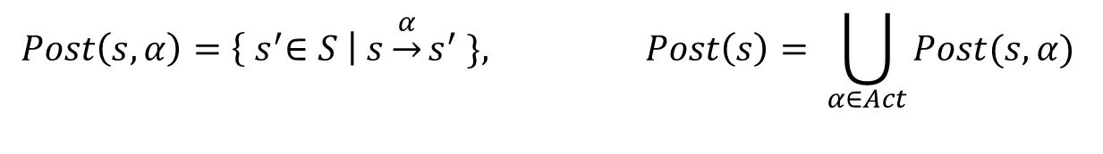
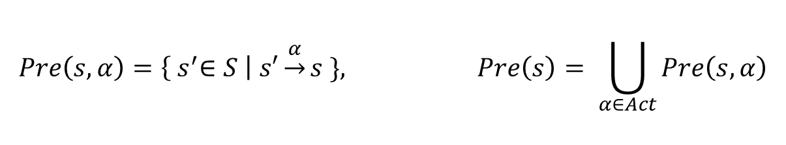
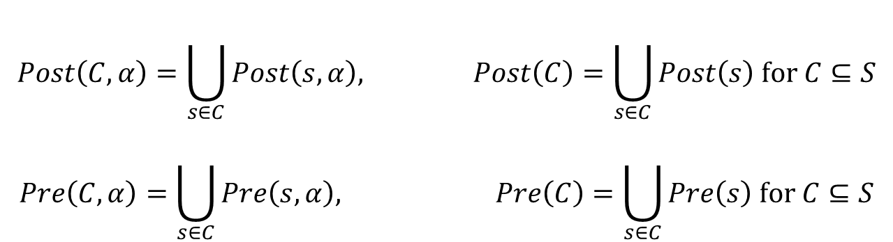
Direct successors and predecessors
$$Post\left(s,α\right)=\left\{{ s}^{′}∈S \right| s\underset{→}{α}s^{′} \}, Post\left(s\right)= \bigcup_{α∈Act}{Post(s, α)}$$
$$Pre\left(s,α\right)=\left\{{ s}^{′}∈S \right| s′\underset{→}{α}s \}, Pre\left(s\right)= \bigcup_{α∈Act}{Pre\left(s, α\right)}$$
$$Post\left(C, α\right)=\bigcup_{s∈C}{Post\left(s,α\right), Post\left(C\right)=\bigcup_{s∈C}{Post\left(s\right) \text{for} C⊆S}}$$
$$Pre\left(C, α\right)=\bigcup_{s∈C}{Pre\left(s,α\right), Pre\left(C\right)=\bigcup_{s∈C}{Pre\left(s\right) \text{for} C⊆S}}$$
State s is called terminal if and only if $Post\left(s\right)= ∅$

Slide 7
Action and AP-determinism
Transition system TS = (S, Act, →, I, AP, L) is action-deterministic iﬀ:
| I | < = 1 and | Post(s, α) | < = 1 for all s,a
Transition system TS = (S, Act, →, I, AP, L) is AP-deterministic iﬀ:
| I | <=1 and | Pos t(s) ∩ { s’ ∈ S | L(s') = A } | <= 1 for all s, A ∈ 2^{AP}
equally labeled successors of s

Slide 8
The role of non-determinism
Here: nondeterminism is a feature!
to model concurrency by interleaving
no assumption about the relative speed of processes
to model implementation freedom
only describes what a system should do, not how
to model under-speciﬁed systems, or abstractions of real systems
use incomplete information
In automata theory, nondeterminism may be exponentially more succinct but that’s not the issue here!

Slide 9
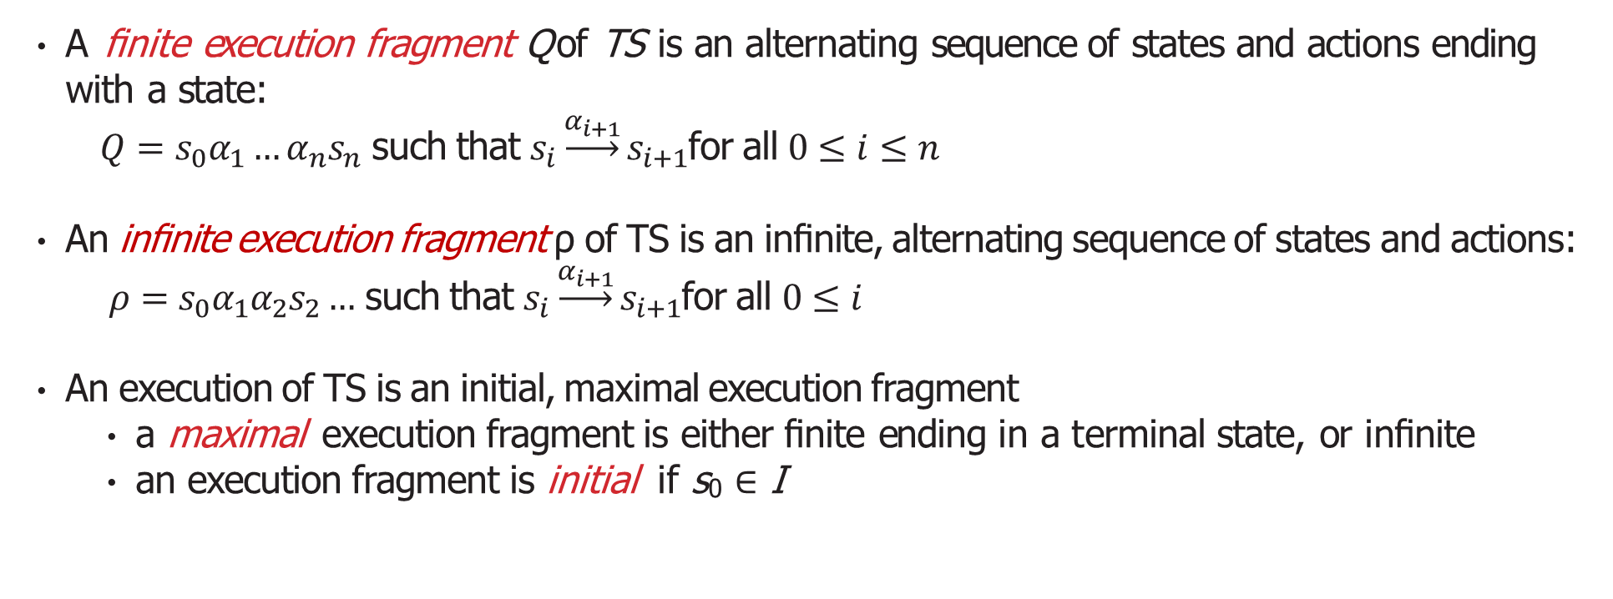
Executions
A ﬁnite execution fragment Q of TS is an alternating sequence of states and actions ending with a state:
$Q=s_{0}α_{1}…α_{n}s_{n}$ such that $s_{i}\underset{→}{α_{i+1}}s_{i+1}$for all $0≤i≤n$
An inﬁnite execution fragment ρ of TS is an inﬁnite, alternating sequence of states and actions:
$ρ=s_{0}α_{1}α_{2}s_{2}…$ such that $s_{i}\underset{→}{α_{i+1}}s_{i+1}$for all $0≤i$
An execution of TS is an initial, maximal execution fragment
a maximal execution fragment is either ﬁnite ending in a terminal state, or inﬁnite
an execution fragment is initial if s₀ ∈ I

Slide 10
Example Executions
ρ₁ =
_{pay} coin τ sget
−−→ select −→ sprite −−−→ pay
coin τ sget
−−−→ select −→ sprite −−−→ .. .
τ sget coin
τ cget
ρ₂ = select −→
Q =
sprite −−−→ pay −−−→ select −→
coke −−−→ .. .
coin τ sget coin
τ
pay −−−→ select −→ sprite −−−→ pay −−−→ select −→ sprite
Execution fragments ρ₁ and Q are initial, but ρ₂ is not
Q is not maximal as it does not end in a terminal state
Assuming that ρ₁ and ρ₂ are inﬁnite, they are maximal

Slide 11
Reachable States
State s ∈ S is called reachable in TS if there exists an initial, ﬁnite execution fragment
^{α}1 ^{α}2 αn
.. . = s .
s₀ −−→ s₁ −−→ −−→ s_{n}
Reach(TS) denotes the set of all reachable states in TS.

Slide 12

Modeling Sequential Circuits
{y}
{x}
x
XOR
NOT
y
x 0 r 0
x 1 r 0
OR
x 0 r 1
x 1 r 1
r
{r}
{x r y}
Transition system representation of a simple hardware circuit Input variable x, output variable y, and register r
Output function ¬(x ⊕ r) and register evaluation function x ∨ r

Slide 13
Atomic Propositions
Consider two possible state-labelings:
Let AP = { x, y, r }
– L((x = 0,r = 1)) = { r } and L((x = 1,r = 1)) = { x, r, y }
– L((x = 0,r = 0)) = { y } and L((x = 1,r = 0)) = { x }
property e.g., “once the register is one, it remains one”
Let AP' = { x, y } – the register evaluations are now “invisible”
– L((x = 0,r = 1)) = ∅ and L((x = 1,r = 1)) = { x, y }
– L((x = 0,r = 0)) = { y } and L((x = 1,r = 0)) = { x }
property e.g., “the output bit y is set inﬁnitely often”

Slide 14
Some Preliminaries
typed variables with a valuation that assigns values to variables
– e.g., η(x) = 17 and η(y) = −2
the set of Boolean conditions over Var
propositional logic formulas whose propositions are of the form “x ∈ D”
– (−3 < x <= 5) ∧ (y = green) ∧ (x :( 2·x')
eﬀect of the actions is formalized by means of a mapping:
Eﬀect : Act × Eval(Var) → Eval(Var)
e.g., α ≡ x := y+5 and evaluation η(x) = 17 and η(y) = −2
– Eﬀect(α, η)(x) = η(y)+ 5 = 3, and Eﬀect(α, η)(y) = η(y) = −2

Slide 15
Program Graphs
A program graph PG over set Var of typed variables is a tuple
(Loc, Act, Eﬀect, −→, Loc₀, g₀)
where
Loc is a set of locations with initial locations Loc₀ ⊆ Loc
Act is a set of actions
Eﬀect : Act × Eval(Var) → Eval(Var) is the eﬀect function
−→ ⊆ Loc × ( Cond( Var )×Act ) × Loc, transition relation
g₀ ∈ Cond(Var) is the initial condition.
g:α
Notation: l−−→ l ' denotes (l , g, α, l' ) ∈ −→

Slide 16
Beverage Vending Machine
Loc = { start, select } with Loc₀ = { start }
Act = { cget, sget, coin, ret_coin, refill }
Var = { nsprite, ncoke } with domain { 0, 1, …, max }
Effect( coin, η ) = η
Effect( ret_coin, η ) = η
Effect( sget, η ) = η[ nsprite := nsprite − 1 ]
Effect( cget, η ) = η[ ncoke := ncoke − 1 ]
Effect( refill, η ) = η[ nsprite := max, ncoke := max ]
g₀ = ( nsprite = max ∧ ncoke = max )

Slide 17
From program graphs to transition systems
Basic strategy: unfolding
state = location (current control) l + data valuation η
initial state = initial location satisfying the initial condition g₀
Propositions and labeling
propositions: “at l ” and “x ∈ D” for D ⊆ dom(x)
(l , η) is labeled with “at l ” and all conditions that hold in η
g:α α
l −−−→ l' and g holds in η then (l , η) −−→ (l , Eﬀect(α, η))

Slide 18
Structured operational semantics
premise
The notation
means:
conclusion
If the proposition above the “solid line” (i.e., the premise) holds, then the proposition under the fraction bar (i.e., the conclusion) holds
Such “if .. ., then .. .” propositions are also called inference rules
If the premise is a tautology, it may be omitted (as well as the “solid line”)
In the latter case, the rule is also called an axiom

Slide 19
Transition Systems for Program Graphs
The transition system TS(PG) of program graph
PG = (Loc, Act, Eﬀect, →, Loc₀, g₀)
over set Var of variables is the tuple (S, Act, →, I, AP, L) where
S = Loc × Eval(Var)
→ ⊆ S × Act × S is deﬁned by the rule: $\frac{l\underset{→}{g:α}l^{′} ∧ η⊨g}{(l, η)\underset{→}{α}(l^{′}, \text{Effect}\left(α,η\right))}$
• I = {(l , η) | l ∈ Loc₀,η |= g₀ }
AP = Loc ∪ Cond (Var) and L((l , η)) = {l } ∪ {g ∈ Cond (Var) | η |= g}.

Slide 20
Transition systems versus Finite Automata
As opposed to ﬁnite automata, in a transition system:
there are no accept states
set of states and actions may be countably inﬁnite
may have inﬁnite branching
actions may be subject to synchronization
nondeterminism has a diﬀerent role
Transition systems are appropriate for reactive system behaviour

